Slide 1
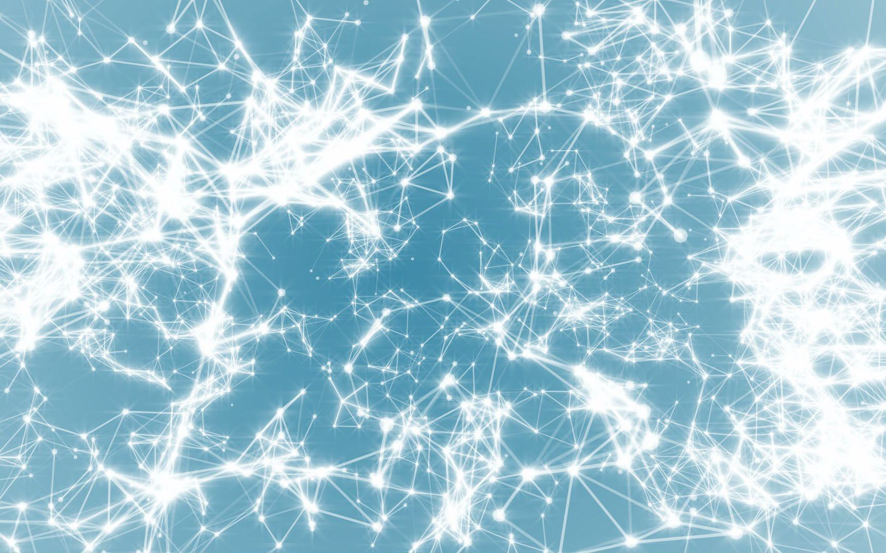
Frontiers of Network Science Fall 2024
Class 1: Introduction (Chapter 1 in Textbook)
Boleslaw Szymanski
1
based on slides by Albert-László Barabási & Roberta Sinatra

Slide 2
Course CSCI-6250/4250 4cr: Frontier of Network Science Monday - Thursday 12:00 - 13:40, Amos Eaton 216
Class Web-site
http://www.cs.rpi.edu/~szymansk/fns.24/index.php
Instructor: Prof. Boleslaw K. Szymanski, email: szymab@rpi.edu
Teaching Assistant: Vijay, Sadashivaiah e-mail: sadasv2@rpi.edu
Office Hours: Monday & Thursday, 15:00 – 16:00 by appointment by email either in the office (TBA) or by Webex link: https://rensselaer.webex.com/meet/sadasv2
Textbooks
Albert Laszlo Barabasi Network Science, Cambridge University Press, 2016
Available online at http://barabasi.com/networksciencebook/
In addition, class notes will be used.

Slide 3
Course Description
This course offers an introduction to Network Science and a review of current research in this field. Classes will interchangeably present chapters from the textbook and the related current research. The emphasis will be on the mathematical background of network science: graphs and networks; random networks and various types of scale-free networks; and on network properties such as assortativity, mobility, and robustness; social networks and communities; and dynamics of processes on networks.
Course Content
Mathematical background of network science: graphs and networks.
Random networks and their properties.
Scale-free networks, small world networks and Barabasi-Alert model.
Mobility and networks
Network robustness
Social networks and communities
Assortativity of networks
Dynamic processes

Slide 4
Grading Criteria
Undergraduates:
One individual programming homework (40% of the total grade), followed by one individual presentation of the selected research paper or textbook problem (50% of the total grade), with questions and participation in discussions for at least two student presentations will providing the remaining (10%) of the total grade.
The programming homework will be handed out approximately after the end of the 4th week, together with choices of networks for experiments, and due in three weeks after that. The homework will require using network analysis tools (or programming) and analysis of the results obtained for the real and synthetic networks. The graded homework will be returned to undergraduates approximately one week after they are handed in. Students will have these grades as their means to determine progress in the course by mid-semester.
Students need to choose a topic for research and presentation either from the list of problems associated with the textbook or from the seminal papers that need to be approved by the instructor by the 7th week. The 25 min in class presentation + 5 min discussion of the assigned
topic will be scheduled starting at the end of October.
4

Slide 5
Grading Criteria
Graduates:
Students will choose a topic for research and presentation either from the list of the seminal papers, or from their own current work, and approved by the instructor during the first two weeks of the class.
Around 6th week of the course, the research plan will be due of 3-5 pages defining the project part of the presentation on which research will be based (20%).
The 45 min presentation of the length of typical research length, followed by 5 min discussion will be due to be presented and delivered starting at the end of October (50%).
A written report of 8-12 pages due at the last class (20%). The remaining 10% of the grade will be assigned based on participation in discussions of the presentations.
Grade range for both graduates and undergraduates:
A 96. A- 91, B 85, B- 80, C 70, C- 60, F <60.

Slide 6
Student Learning Outcomes
Student Learning Outcomes:
Upon completion of this course, all students will be able to:
Apply fundamental network science ideas to create models and understand dynamics of networked systems;
Compare, contrast, and describe the similarities and differences of different kinds of networks and processes modeled on networks;
Critique the strengths and weaknesses of each of the models and types of networks based on them and these network types performance in diverse network science applications;
Understand the principles of applying network science to disciplinary science and design and set up basic models for some specific applications.
Additionally, graduate students will also be able to:
Read, analyze, and critique published literature in the field of network science and social networks;
Assess novelty of network science research and its relation to the state of the art in the field.

Slide 7
Course Assessment Measures
Undergraduates: Students' performance will be measured using three different methods:
Programming homework
After selection of a current research paper or textbook problem for presentation, students will presentation the selected papers, including their content, and evaluate their scientific results.
Contributions to in-class discussions
The programming homework and presentation plans will measure the student's ability to apply concepts of network science to networks analysis.
The presentation and discussion of the paper results will measure student's ability to prepare summary material based on fundamental scientific concepts and basic research.
In-class discussion will measure students’ ability to express their views at group meetings.
Graduates: Again, students' performance will be measured using three different methods:
After selection of a current research paper or own research for presentation, students will presentation the selected topics, including content, and evaluate their scientific results.
Contributions to in-class discussions
Independent and novel mini-project on the topic of the presentation using different data, or methods.
The first two methods are the same as undergraduate methods (i) and (iii), while the third
method assesses students’ ability to apply network science tools to novel problems
7

Slide 8
Academic integrity:
Student-teacher relationships are built on trust. For example, students must trust that teachers have made appropriate decisions about the structure and content of the courses they teach, and teachers must trust that the assignments that students turn in are their own. Acts, which violate this trust, undermine the educational process. The Rensselaer Handbook of Student Rights and Responsibilities defines various forms of Academic Dishonesty and all students should make themselves familiar with these forms to avoid them.
In this class, all assignments that are turned in for a grade must represent the student's own work. Submission of any assignment that is in violation of this policy will result in a penalty of 0 points for assignment and failing of the course in case of repetition.
If you have any question concerning this policy, please ask for clarification before preparing or submitting an assignment or making a presentation.

Slide 9
Use of AI tools
A summary of policy proposed by Ethan Mollick from the University of Pennsylvania
Tools like AI, e.g., ChatGPT, and image generators, e.g., Gephi, are allowed in this class
since learning to use AI is an emerging skill. Be aware of the limits of ChatGPT:
If you provide minimal prompts, you may get low-quality results. Be prepared to enrich
your prompts to get good outcomes.
2. Refrain from trusting anything ChatGPT says. Check the numbers and facts provided
by it. You will be responsible for any errors or omissions the tool offers.
You also must acknowledge its use. This acknowledgment should include a paragraph
at the end of any AI-assisted assignment explaining what you used the AI for and listing
4. the prompts you used. Failure to do so is a severe violation of academic honesty policies.
Please include a paragraph at the end of any assignment that uses AI explaining
what you used the AI for and what and list prompts that you used. Please do so to
uphold the academic honesty policies.

Slide 10
Attendance Policy:
Attendance in classes is in general not required but it is recommended because the material presented in classes includes topics beyond the textbook.
However, the attendance and active participation is required in at least two research presentations with active participation is needed to receive score for active participation.
Missed deadline for homework, unless justified by medical or personal reasons and approved by instructor, will lower the achieved score by 10% for each week of delay.
Presentations can be rescheduled but only in emergencies.

Slide 11
Calendar:
The list shows the topics covered in classes, brown are lectures based on textbook, green are research presentations, and blue are presentations by students.
Aug. 30: L01 Overview and Introduction to Network Science/Graph Theory (chapter 1) Sept.06: L02 Introduction II (chapter 1)
Sept. 10: L03 Graph Theory (chapter 2) topics for student presentations; Sept. 13: L04 Graph Theory II (chapter 2)
Sept. 17: L05 Research: U.S. Senate Clustering; U.S. Congress Polarization II; (Constitution Day)
Sept. 20: Deadline for research topic selections by graduates due before noon
Sept. 20: L06 Random Networks (chapter 3)
Sept. 24: L07 Scale Free Networks (chapter 4);
Sept. 27: L08 Introduction to Gephi + Examples; Undergraduate Assignment out, due Oct. 11
Oct. 01: L09 Q&A session for H1; Barabasi-Albert Model (chapter 5);
Oct. 04: Deadline for undergraduates to register their networks before noon
Oct. 04: L10 Barabasi-Albert Model (chapter 5); Oct. 08: L11 Barabasi-Albert Model II (chapter 5);
Oct. 11: Research plan write-ups & H1’s are due
Oct. 11: L12 Degree Correlation (chapter 7) Oct. 15: L13 Degree Correlation II (chapter 7)

Slide 12
Section 2:
FROM SADDAM HUSSEIN TO NETWORK THEORY
FROM SADDAM HUSSEIN TO NETWORK THEORY

Slide 13
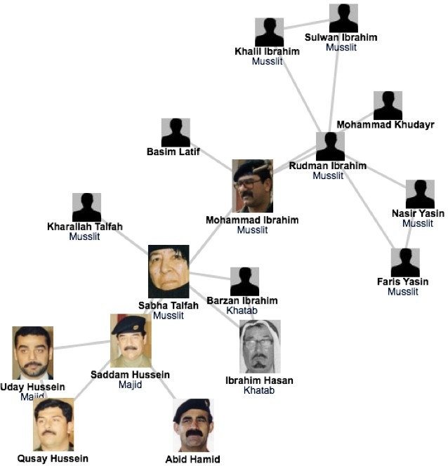
The fate of Saddam and network science
A SIMPLE STORY (1)
Network Science: Introduction

Slide 14
A SIMPLE STORY (1) The fate of Saddam and network science
The capture of Saddam Hussein:
→shows the strong predictive power of networks.
→ underlies the need to obtain accurate maps of the networks we aim to study; and the often heroic difficulties we encounter during the mapping process.
→ demonstrates the remarkable stability of these networks: The capture of Hussein was not based on fresh intelligence, but rather on his pre-invasion social links, unearthed from old photos stacked in his family album.
→ shows that the choice of network we focus on makes a huge difference: the hierarchical tree, that captured the official organization of the Iraqi government, was of no use when it came to Saddam Hussein's whereabouts.

Slide 15
Section 3
VULNERABILITY DUE TO INTERCONNECTIVITY
VULNERABILITY DUE TO INTERCONNECTIVITY
Network Science: Introduction
14

Slide 16
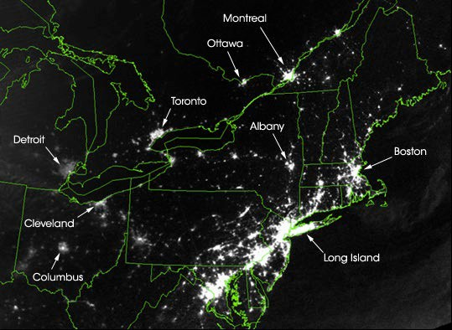
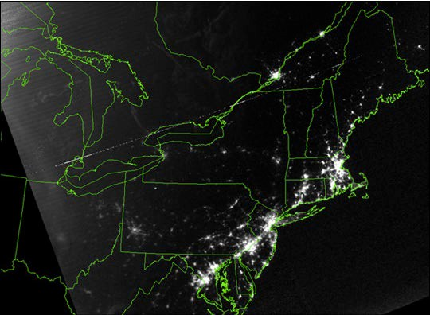
A SIMPLE STORY (2): August 15, 2003 blackout.
August 14, 2003: 9:29pm EDT
20 hours before
August 15, 2003: 9:14pm EDT
7 hours after
Network Science: Int¹ro⁵duction

Slide 17
Section 4
NETWORKS AT THE HEART OF COMPLEX SYSTEMS
NETWORKS AT THE HEART OF COMPLEX SYSTEMS
Network Science: Introduction
16

Slide 18
Stephen Hawking
January 23, 2000`

Slide 19
COMPLEX SYSTEMS
Complexity, a scientific theory which asserts that some systems display behavioral phenomena that are completely inexplicable by any conventional analysis of the systems’ constituent parts. These phenomena, commonly referred to as emergent behaviour, seem to occur in many complex systems involving living organisms, such as a stock market or the human brain.
Source: John L. Casti, Encyclopædia Britannica
[adj., v. kuh m-pleks, kom-pleks; n. kom-pleks] –adjective
1.
composed of many interconnected parts; compound; composite: a complex highway system.
2.
characterized by a very complicated or involved arrangement of parts, units, etc.: complex machinery.
3.
so complicated or intricate as to be hard to understand or deal with: a complex problem.
Source: Dictionary.com

Slide 20
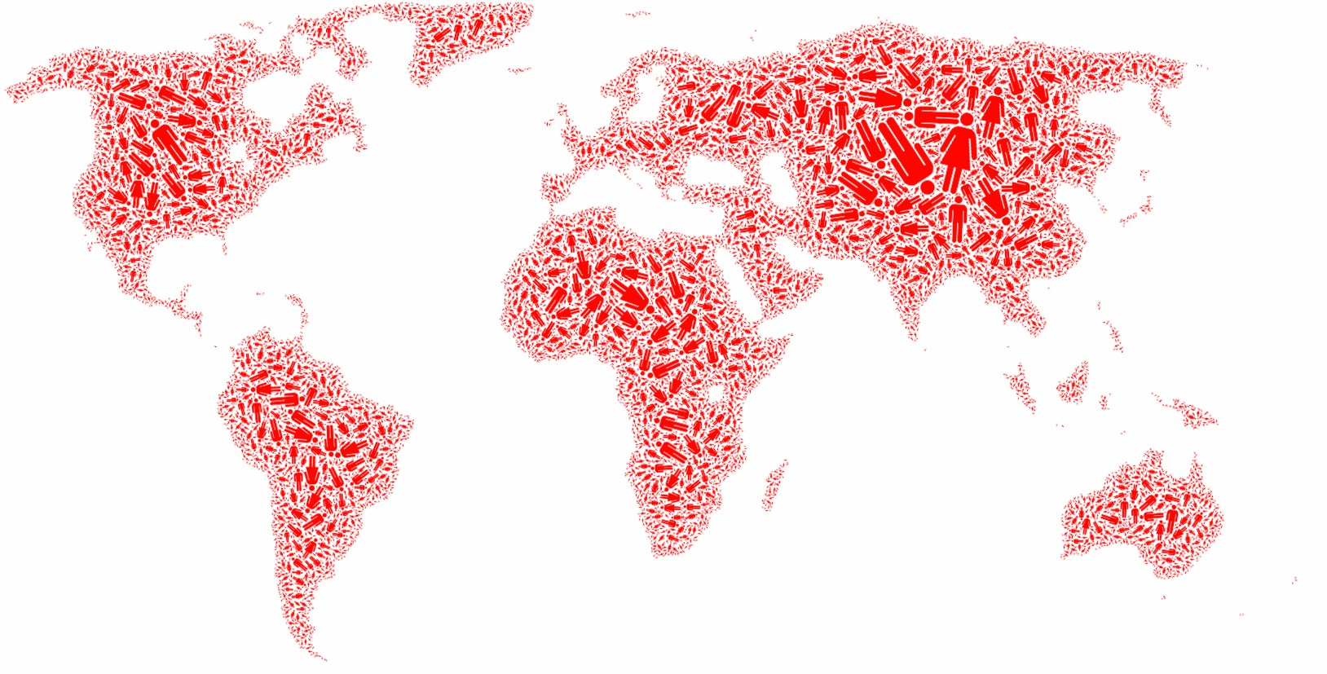
SOCIETY
Factoid:
The population of 9-10 billions people has been predicted by the United States Census Bureau to be in 2050.
http://en.wikipedia.org/wiki/World_population
Network Science: Int¹ro⁹duction

Slide 21
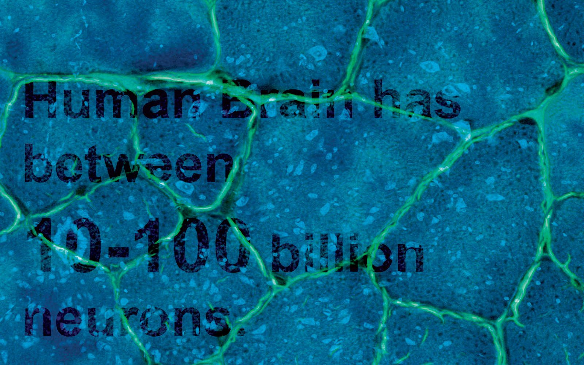
BRAIN
Factoid:
Brain
Factoid:
Human Brain has between 10-100 billion neurons.
Network Science: Int²ro⁰duction

Slide 22
ECONOMY
Factoid:
The world economy will produce goods and services worth $105 trillion in 2023.
(https://en.wikipedia.org/wiki/World_economy)

Slide 23
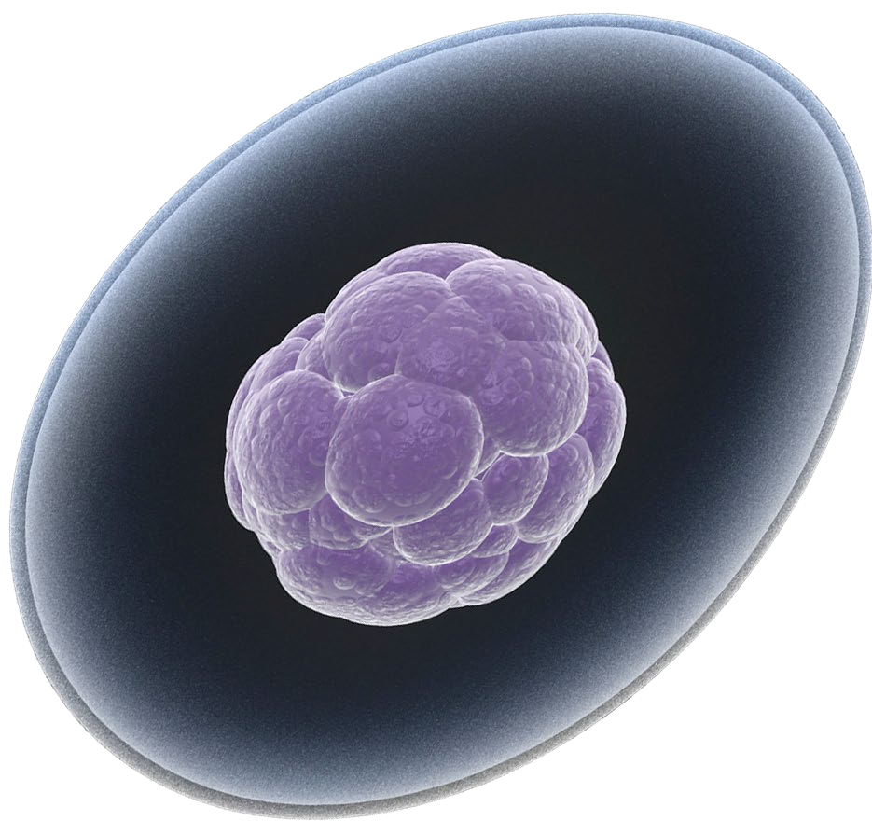
THE HUMAN CELL
Factoid:
How Many Genes are in the Human Genome?
20,500
The latest number from 2007 is 20,500
The 20,500 number of protein-coding genes was presented in a 2007 PNAS paper. Scientists arrived at this number by excluding the (now thought to be functionally meaningless, random occurrences)
M. Clamp et al., 2007. "Distinguishing Protein-Coding and Noncoding Genes in the Human Genome," PNAS 104(49), 19428-19433.]

Slide 24
THE ROLE OF NETWORKS
Behind each complex system there is a network, that defines the interactions between the components.

Slide 25
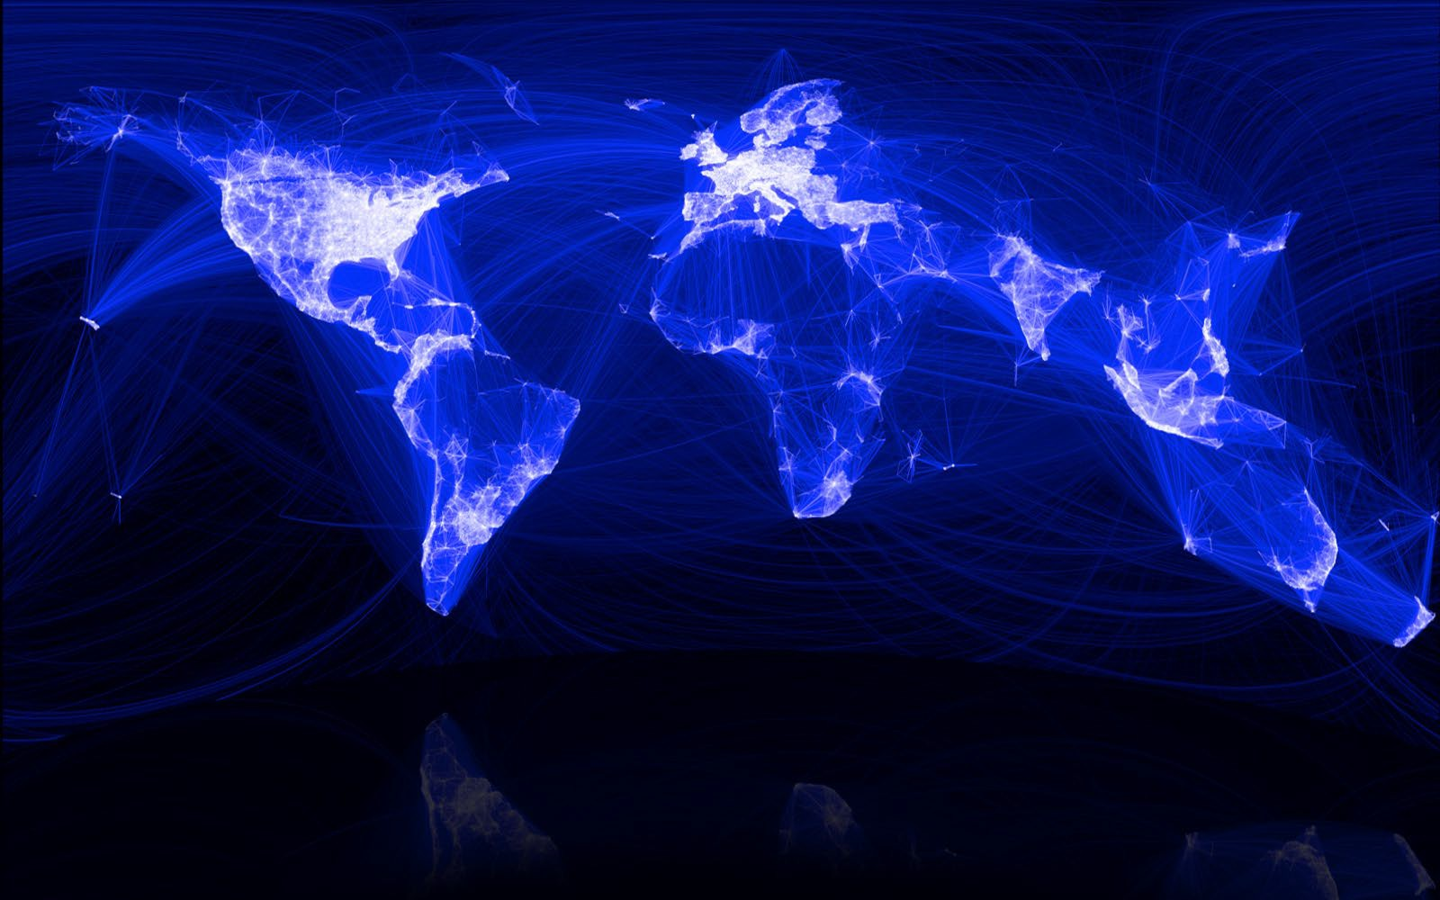
SOCIETY
Factoid:
The “Social Graph” behind Facebook
Keith Shepherd's "Sunday Best”. http://baseballart.com/2010/07/shades-of-greatness-a-story-that-needed-to-be-told/

Slide 26
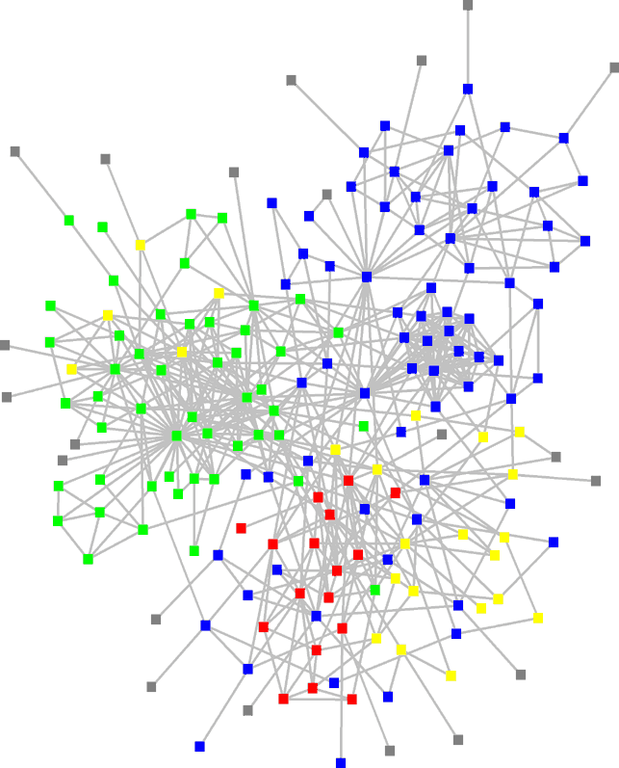
STRUCTURE OF AN ORGANIZATION
: departments
: consultants
: external experts
www.orgnet.com

Slide 27
STRUCTURE OF AN ORGANIZATION
: departments
: consultants
: external experts
www.orgnet.com

Slide 28
The subtle financial networks

Slide 29
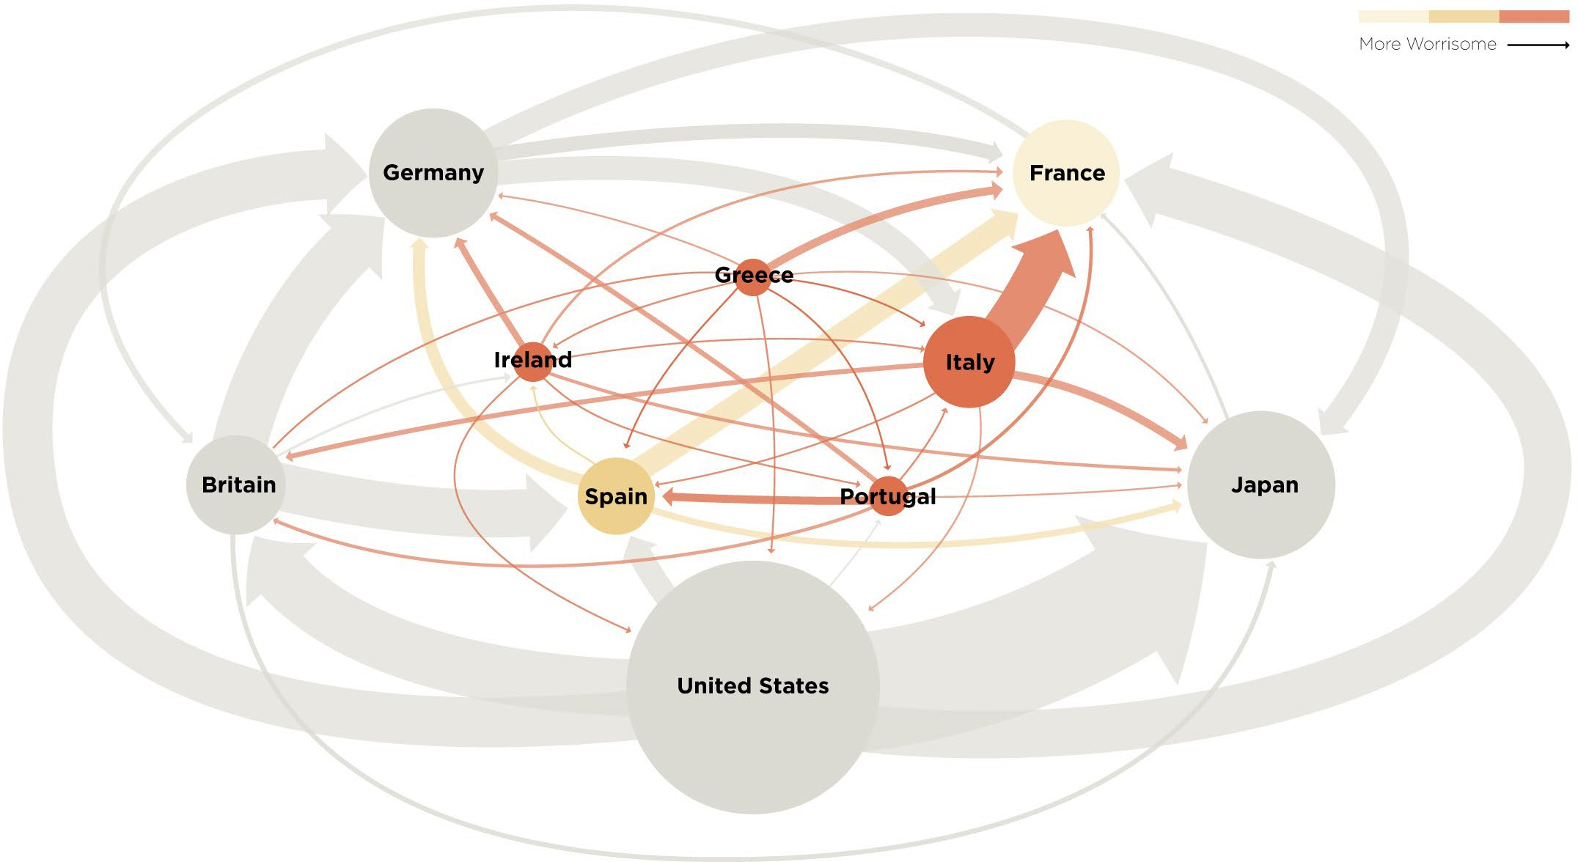
The not so subtle financial networks: 2011

Slide 30
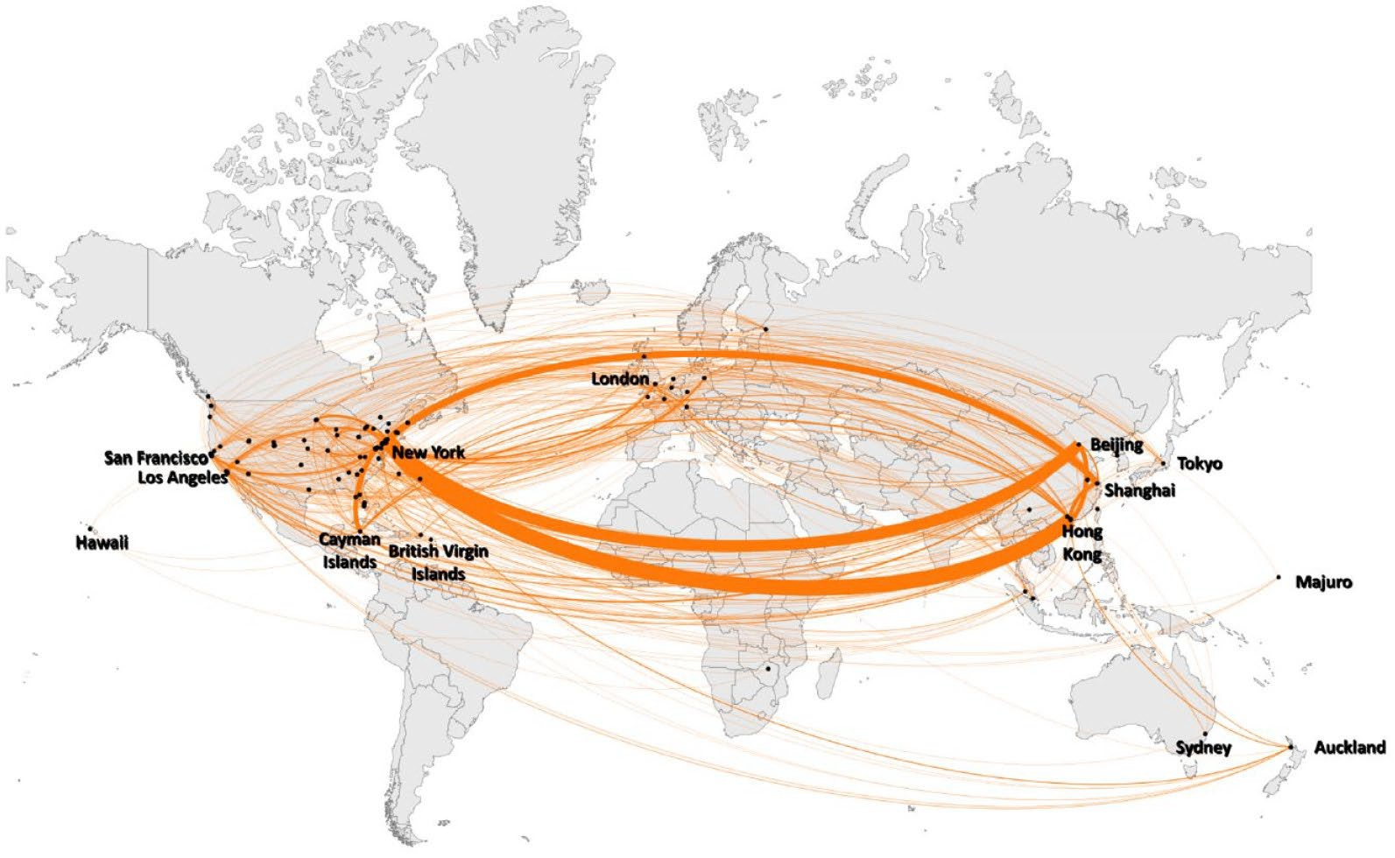
Chinese companies with foreign listings: 2022

Slide 31
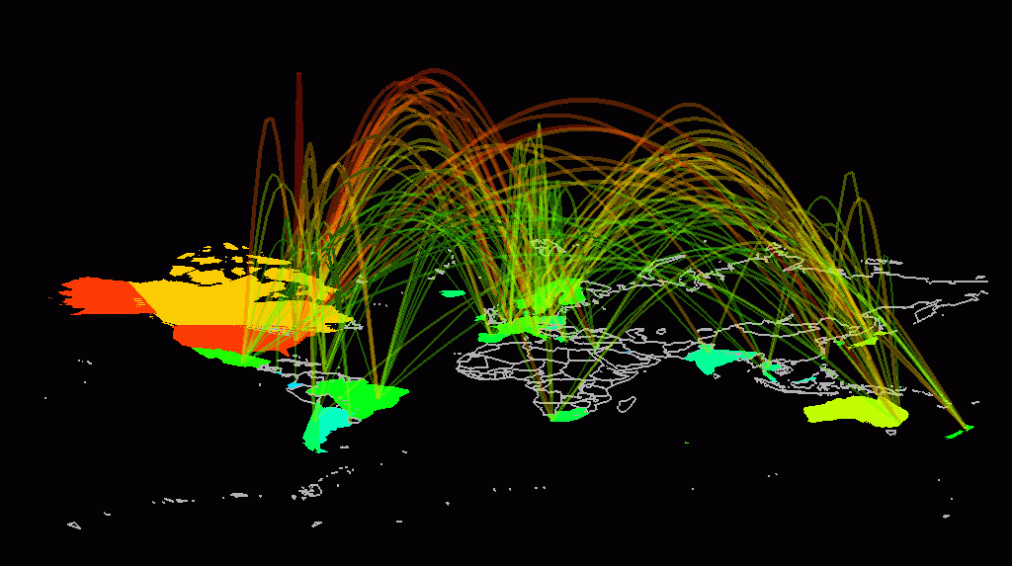
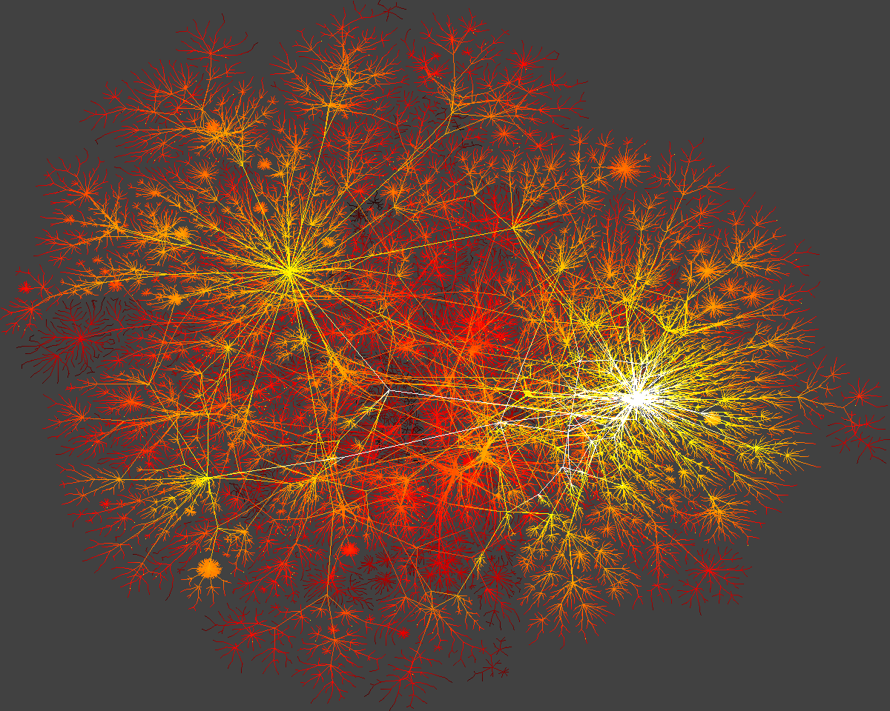
INTERNET
domain2
domain1
router
domain3
Network Science: Introduction
30

Slide 32
ECONOMIC IMPACT
Cisco Systems
Networking gear Market Cap (August 2024):$198 billion -2%
Facebook (Meta)
Market Cap (August 2024):
$1.307 trillion +43%
Alphabet (Google)
Market Cap (August 2024)
$1.944 trillion +10%
Nvidia
Market Cap (August 2024):
$2.63 trillion +115%
Network Science: Introduction
Notes:
Economic Impact: From web search to social networking.
Some of the most successful companies of the 21st century, from Google to Facebook, Twitter, LinkedIn, Cisco to Apple and Akamai, base their technology and business model on networks. Indeed, Google is not only the biggest network mapping operation, building a comprehensive map of the WWW, but its search technology relies on the network characteristics of the Web.
Networks have gained particular popularity with the emergence of Facebook, the company with the oft-emphasized ambition to map out the social network of the whole planet. While Facebook was not the first social networking site, it is likely also not the last: an extensive ecosystem of social networking tools, from Twitter to Orkut, are attracting an impressive number of users (Image 1.6). The tools developed by network science fuel these sites, aiding everything from friend recommendation to advertising.

Slide 33
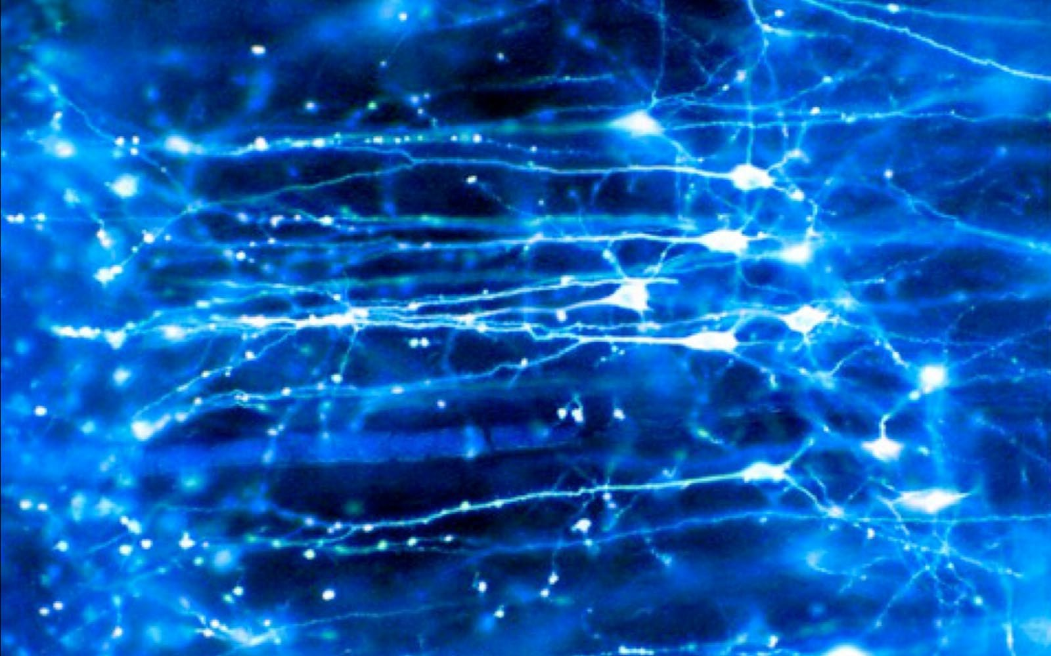
BRAIN
Factoid:
Brain
Human Brain has between 10-100 billion neurons.
Network Science: Int³ro¹duction

Slide 34
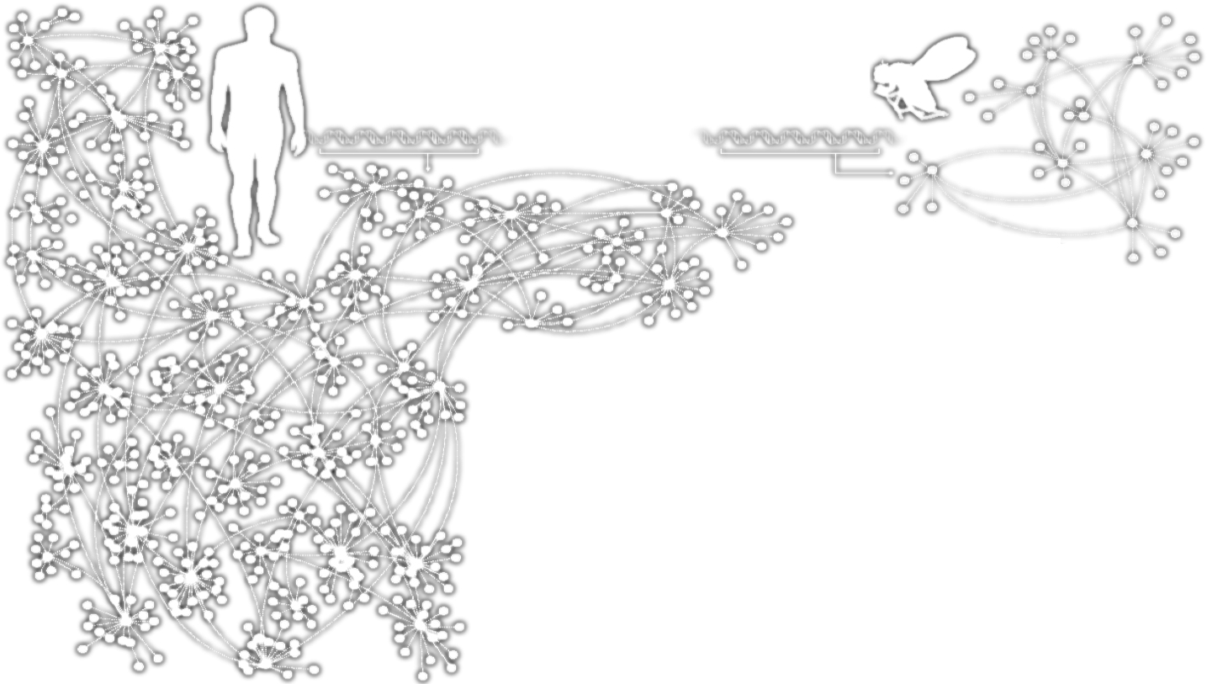
Homo Sapiens
HUMANS GENES
Drosophila Melanogaster
Complex systems
Made of many non-identical elements connected by diverse interactions.
NETWORK
Network Science: Introduction

Slide 35
THE ROLE OF NETWORKS
Behind each system studied in complexity there is an intricate wiring diagram, or a network, that defines the interactions between the component.
We will never understand complex system unless we map out and understand the networks behind them.
Network Science: Introduction

Slide 36
Section 5
TWO FORCES HELPED THE EMERGENCE OF NETWORK SCIENCE
Network Science: Introduction

Slide 37
THE EMERGENCE OF NETWORK SCIENCE
The emergence of network maps:
Movie Actor Network, 1998; World Wide Web, 1999.
C elegans neural wiring diagram 1990 Citation Network, 1998
Metabolic Network, 2000;
PPI network, 2001
Network Science: Introduction

Slide 38
THE EMERGENCE OF NETWORK SCIENCE
The universality of network characteristics:
The architecture of networks emerging in various domains of science, nature, and technology are more similar to each other than one would have expected.
Network Science: Introduction

Slide 39
THE EMERGENCE OF NETWORK SCIENCE
Data Availability:
C elegans neural wiring diagram 1990 Movie Actor Network, 1998
Citation Network, 1998 World Wide Web, 1999 Metabolic Network, 2000
PPI network, 2001
The architecture of networks emerging in various domains of science, nature, and technology are more similar to each other than one would have expected.
Despite the challenges complex systems offer us, we cannot afford to not address their behavior, a view increasingly shared both by scientists and policy makers. Networks are not only essential for this journey, but during the past decade some of the most important advances towards understanding complexity were provided in context of network theory.
Universality:
The (urgent) need to understand complexity:
Network Science: Int³ro⁷duction

Slide 40
THE HISTORY OF NETWORK ANALYSIS
Graph theory: 1735, Euler
Social Network Research: 1930s, Moreno Communication networks/internet: 1960s Ecological Networks: May, 1979.
Network Science: Introduction
38

Slide 41
THE TOOLS OF MODERN NETWORK THEORY
Graph theory
Social network theory
Statistical physics
Computer science
Biology
Statistics
Network Science: Int³ro⁹duction

Slide 42
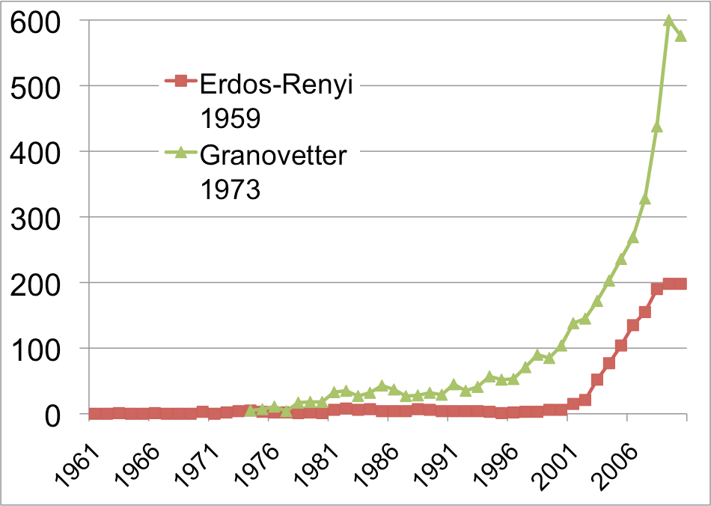
THE HISTORY OF NETWORK ANALYSIS
Network Science: Introduction

Slide 43
Section 6
THE CHARACTERISTICS OF NETWORK SCIENCE
Network Science: Introduction

Slide 44
THE CHARACTERISTICS OF NETWORK SCIENCE
Interdisciplinary
Empirical Quantitative and Mathematical
Computational
Network Science: Introduction

Slide 45
THE CHARACTERISTICS OF NETWORK SCIENCE
Interdisciplinary
Empirical, data driven Quantitative and Mathematical
Computational
Network Science: Introduction

Slide 46
THE CHARACTERISTICS OF NETWORK SCIENCE
Interdisciplinary
Empirical Quantitative and Mathematical
Computational
Network Science: Introduction

Slide 47
THE CHARACTERISTICS OF NETWORK SCIENCE
Interdisciplinary
Empirical Quantitative and Mathematical
Computational
Network Science: Introduction

Slide 48
Section 7
THE IMPACT OF NETWORK SCIENCE
Network Science: Introduction

Slide 49
Quantum Mechanics: 1900
THE IMPACT OF NETWORK SCIENCE
-electron microscope 1931
-transistor 1947
-laser 1957
-magnetic resonance imaging 1973
-quantum computing 2015
Much of modern technology operates at a scale where quantum effects are significant.
At least a 30 year gap between the science and technology.
Network Science: Int⁴ro⁷duction

Slide 50
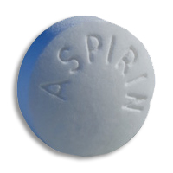
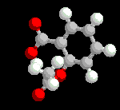
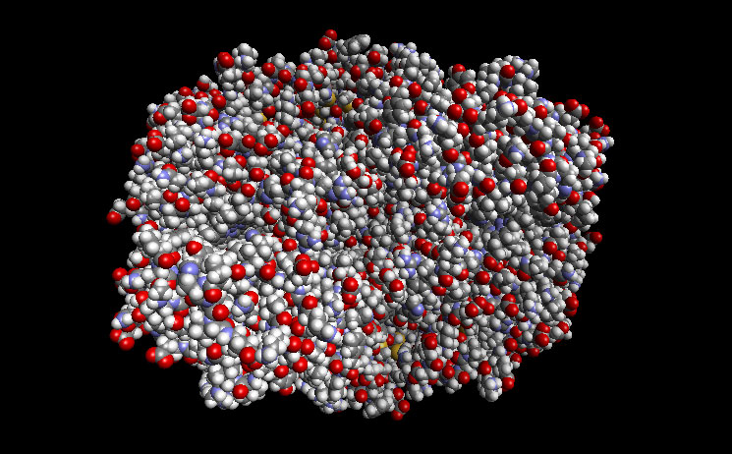
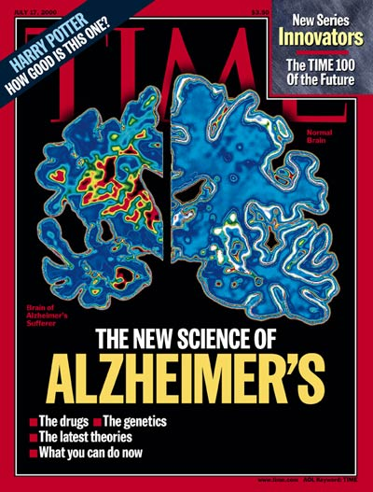
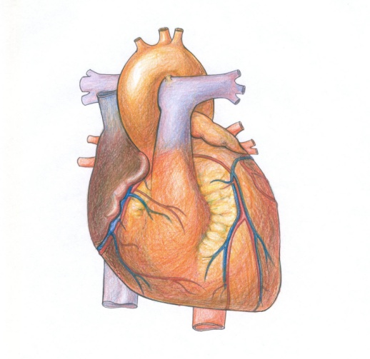
DRUG DESIGN, METABOLIC ENGINEERING:
Reduces
Inflammation
Fever
Pain
Causes
Bleeding
Ulcer
COX2
Prevents
Heart attack
Stroke
Reduces the risk of
Alzheimer's Disease
Reduces the risk of
breast cancer
ovarian cancers
colorectal cancer
Network Science: Introduction
Notes:
Health: From drug design to metabolic engineering.
The human genome project, completed in 2001, offered the first comprehensive list of all human genes. Yet, to fully understand how our cells function, and the origin of disease, we need accurate maps that tell us how these genes and other cellular components interact with each other. Most cellular processes, from the processing of food by our cells to sensing changes in the environment, rely on molecular networks. The breakdown of these networks is responsible for most human diseases. This has led to the emergence of network biology, a new subfield of biology that aims to understand the behavior of cellular networks. A parallel movement within medicine, called network medicine, aims to uncover the role of networks in human disease (Image 1.7a/b). Networks are particularly import- ant in drug development. The ultimate goal of network pharmacology is to develop drugs that can cure diseases without significant side effects. This goal is pursued at many levels, from millions of dollars invested to map out cellular networks to the development of tools and databas- es to store, curate, and analyze patient and genetic data. Several new companies take advantage of these opportuni- ties, from GeneGo that aims to collect accurate maps of celllular interactions from scientific literature to Genomatica that uses the predictive power behind metabolic networks to identify drug targets in bacteria and humans. Recently most major pharmaceutical companies have made significant investments in network and systems medicine, seeing it as the path towards future drugs.

Slide 51
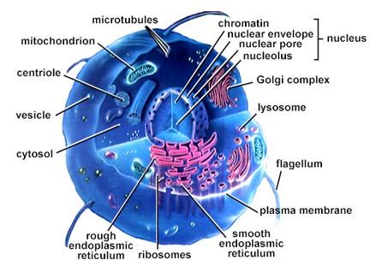
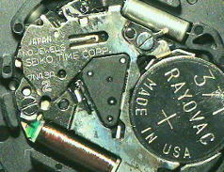
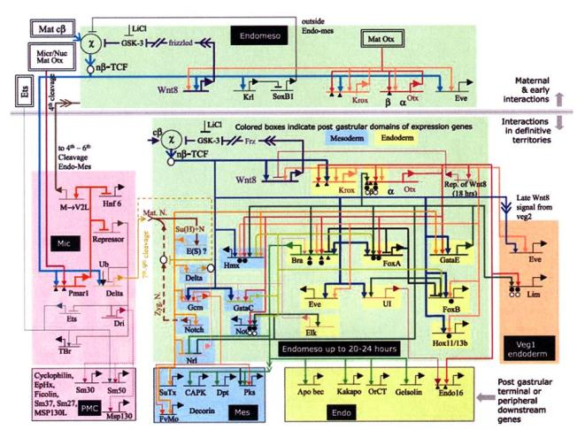
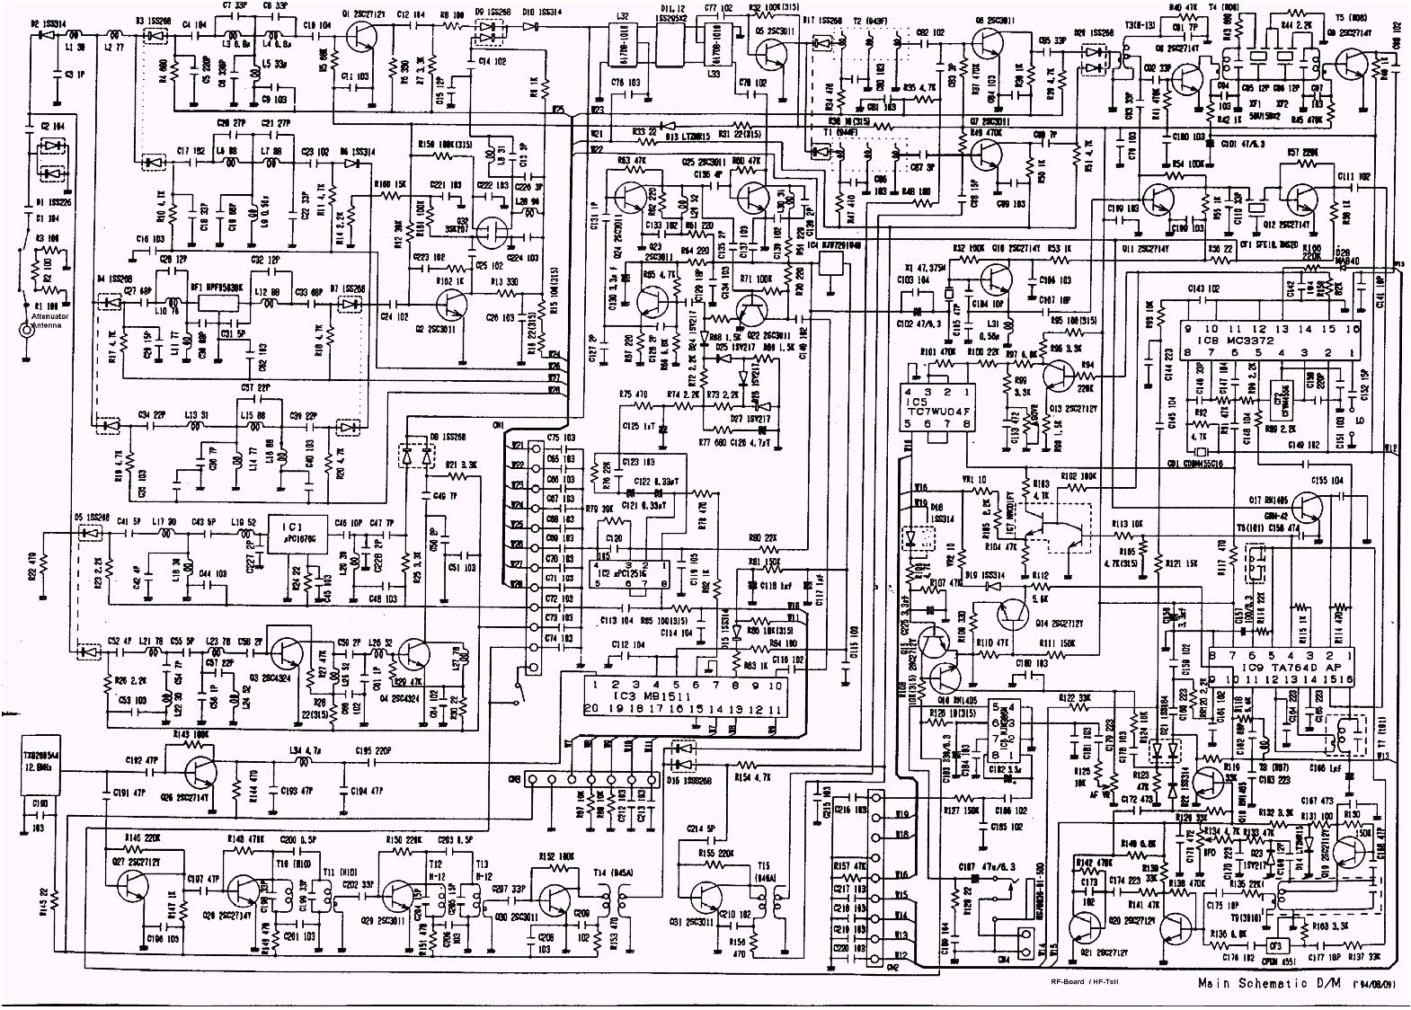
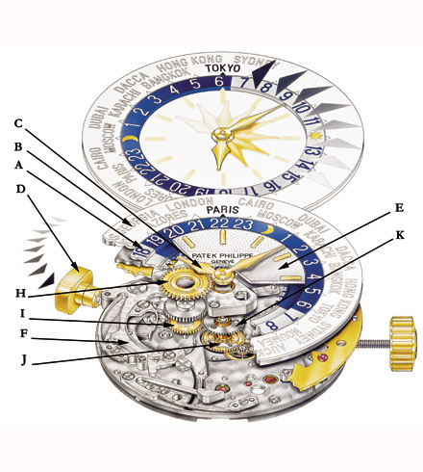
DRUG DESIGN, METABOLIC ENGINEERING:
Notes:
Health: From drug design to metabolic engineering.
The human genome project, completed in 2001, offered the first comprehensive list of all human genes [9, 10]. Yet, to fully understand how our cells function, and the origin of disease, we need accurate maps that tell us how these genes and other cellular components interact with each other. Most cellular processes, from the processing of food by our cells to sensing changes in the environment, rely on molecular networks. The breakdown of these networks is responsible for most human diseases. This has led to the emergence of network biology, a new subfield of biology that aims to understand the behavior of cellular networks. A parallel movement within medicine, called network medicine, aims to uncover the role of networks in human disease (Image 1.7a/b). Networks are particularly import- ant in drug development. The ultimate goal of network pharmacology is to develop drugs that can cure diseases without significant side effects. This goal is pursued at many levels, from millions of dollars invested to map out cellular networks to the development of tools and databases to store, curate, and analyze patient and genetic data. Several new companies take advantage of these opportunities, from GeneGo that aims to collect accurate maps of cellular interactions from scientific literature to Genomatica that uses the predictive power behind metabolic networks to identify drug targets in bacteria and humans. Recently most major pharmaceutical companies have made significant investments in network and systems medicine, seeing it as the path towards future drugs.

